Slide 1
Karnaugh Maps (K-Maps)
A visual way to simplify logic expressions
It gives the most simplified form of the expression

Slide 2
Rules to obtain the most simplified expression
Simplification of logic expression using Boolean algebra is awkward because:
  it lacks specific rules to predict the most suitable next step in the simplification process
  it is difficult to determine whether the simplest form has been achieved.
A Karnaugh map is a graphical method used to obtained the most simplified form of an expression in a standard form (Sum-of-Products or Product-of-Sums).
The simplest form of an expression is the one that has the minimum number of terms with the least number of literals (variables) in each term.
By simplifying an expression to the one that uses the minimum number of terms, we ensure that the function will be implemented with the minimum number of gates.
By simplifying an expression to the one that uses the least number of literals for each terms, we ensure that the function will be implemented with gates that have the minimum number of inputs.

Slide 3
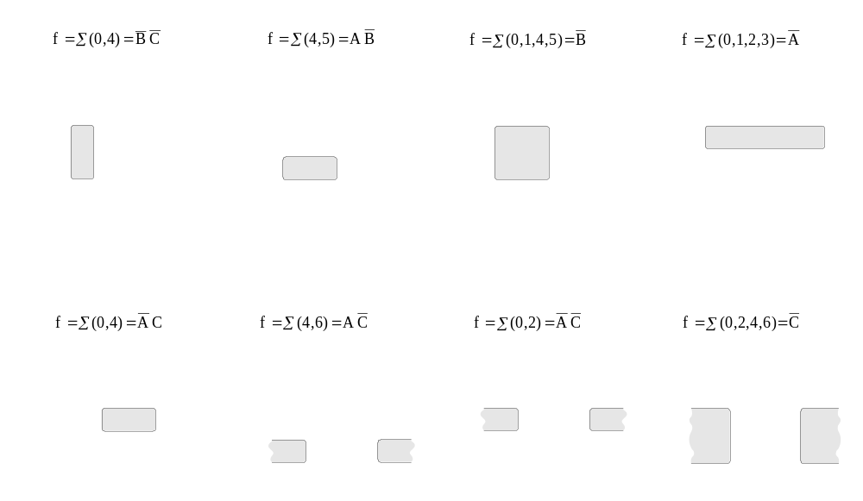
Three-Variable K-Maps

Slide 4
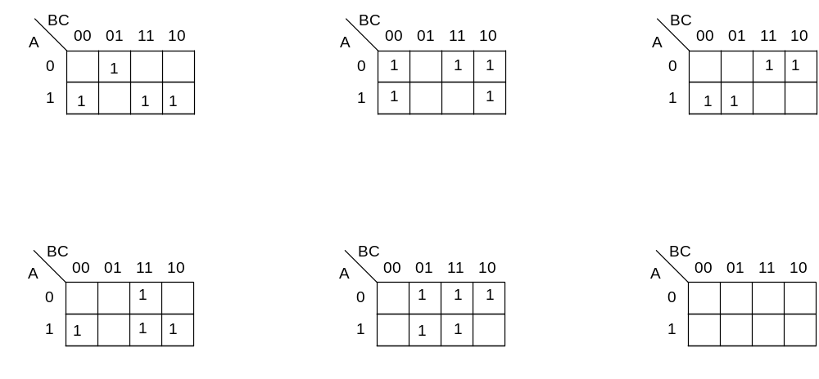
Three-Variable K-Map Examples

Slide 5
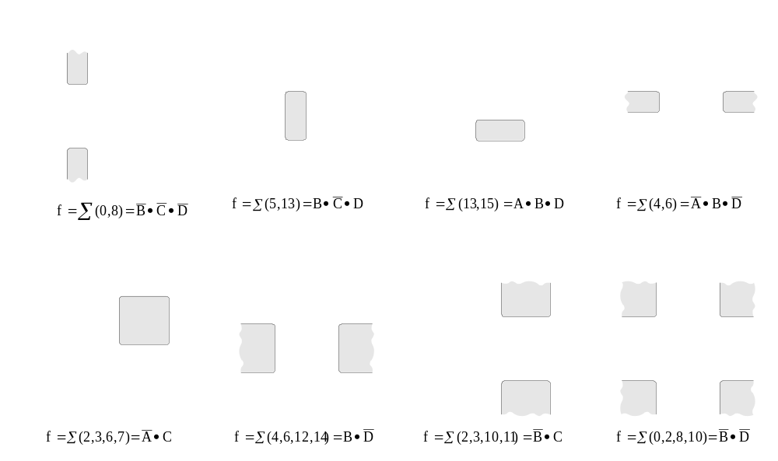
Four-Variable K-Maps

Slide 6
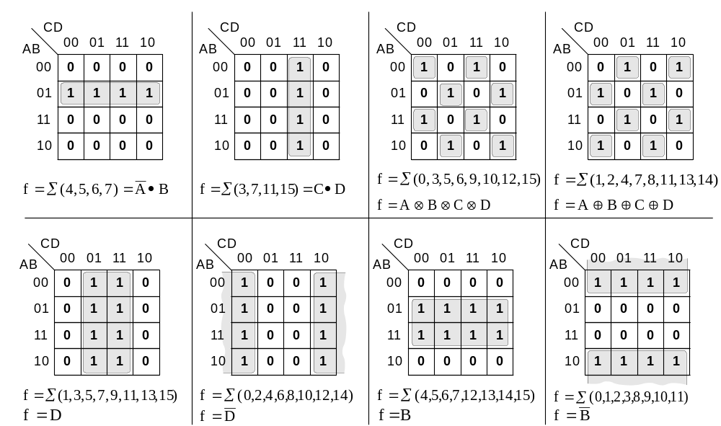
Four-Variable K-Maps

Slide 7
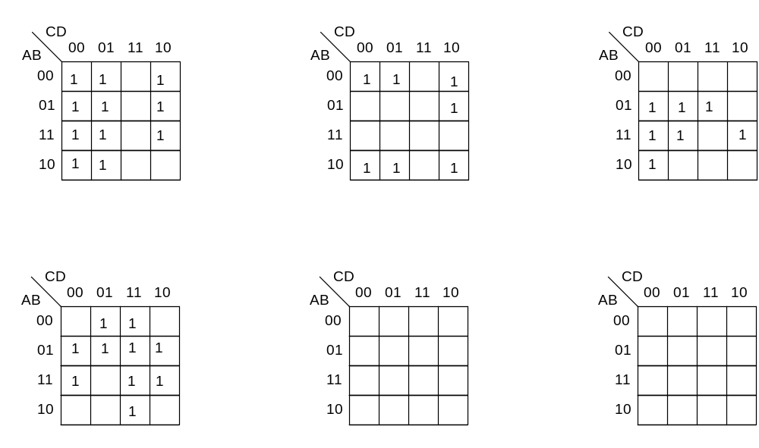
Four-Variable K-Maps Examples

Slide 8
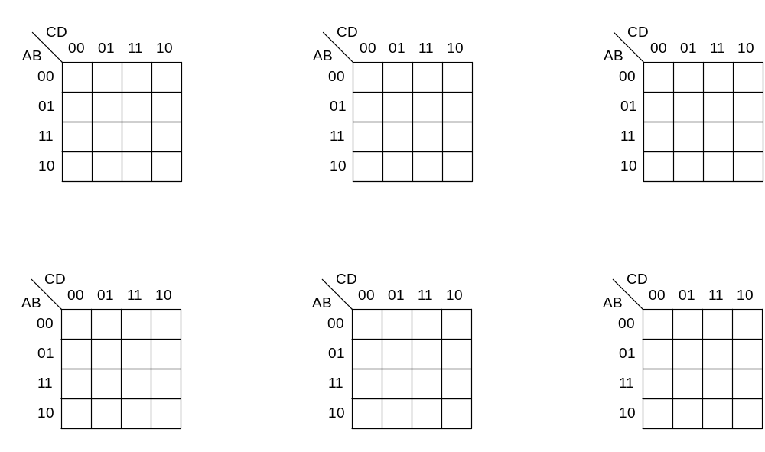
Four-Variable K-Maps Examples

Slide 9
Four-Variable K-Maps Examples

Slide 10
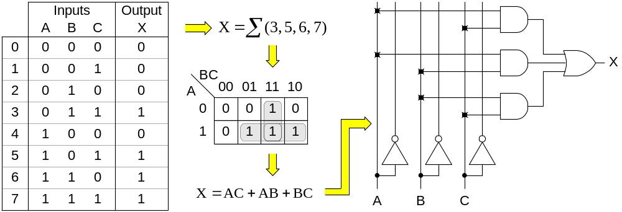
Design of combinational digital circuits
Steps to design a combinational digital circuit:
  From the problem statement derive the truth table
  From the truth table derive the unsimplified logic expression
  Simplify the logic expression
  From the simplified expression draw the logic circuit
Example: Design a 3-input (A,B,C) digital circuit that will give at its output (X) a logic 1 only if the binary number formed at the input has more ones than zeros.

Slide 11
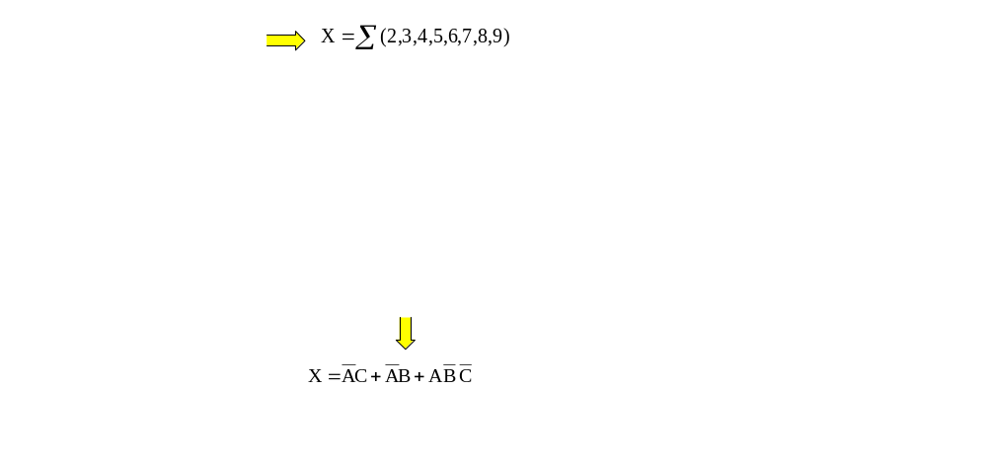
Design of combinational digital circuits (Cont.)
Example: Design a 4-input (A,B,C,D) digital circuit that will give at its output (X) a logic 1 only if the binary number formed at the input is between 2 and 9 (including).

Slide 12
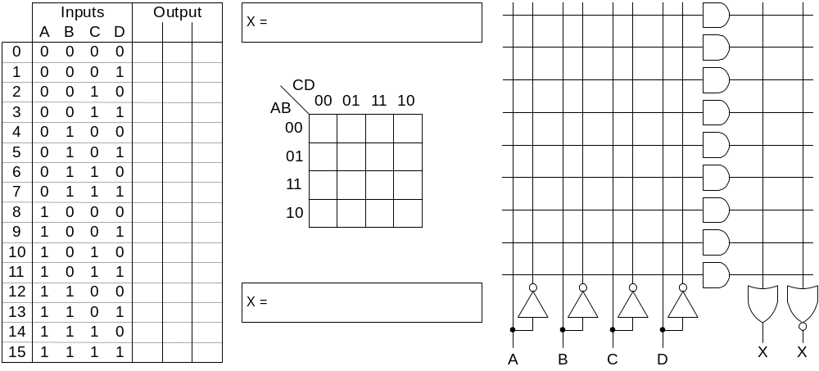
Design of combinational digital circuits (Example)
Example: Design a 4-input (A,B,C,D) digital circuit that will give at its output (X) a logic 1 only if there more ones than zeros in the binary number formed at the input.

